Slide 1

Bus Tap
ALCARAZ, ANNA LYNN C.
ANGOT, SAMMY BOY M.
BESMANO, JUSTIN V.
BRIOSO, JOB G.

Slide 2
Introduction

Slide 3
BGC Bus
44,000 passengers daily (weekdays)
20,000 passengers daily (weekends)
51 buses
75 passengers

Slide 4
Passenger complaints
Long waiting time
Long queue of passengers

Slide 5
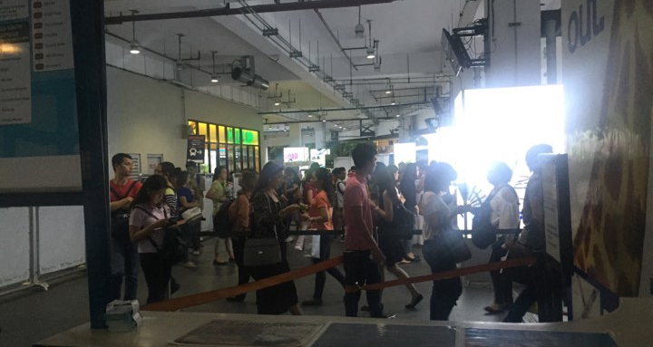
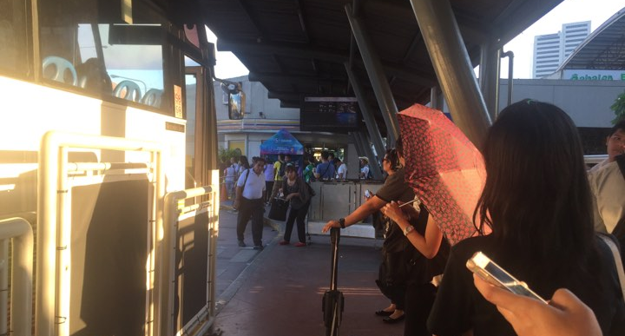
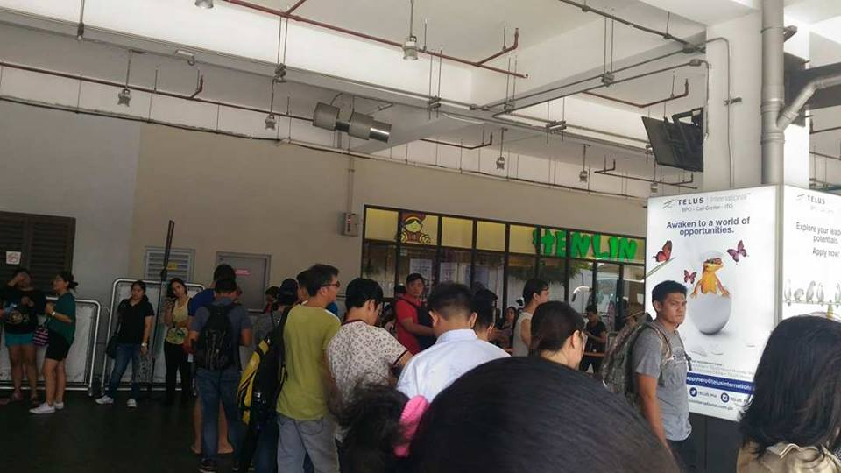
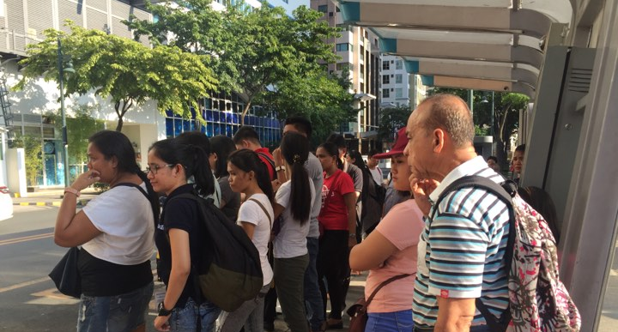

Slide 6
Goal of BGC Bus
standard waiting time: 10 minutes

Slide 7
August 9, 2017, W, 6:00PM to 7:30PM
Terminal/Stop | Destination | Waiting Time
BGC Bus Ayala Terminal | Lower West Route | 4:49.12
 | Lower West Route | 16:24.33
 | Lower West Route | 5:56.43
 | Upper West Route | 7:42.31
 | Upper West Route | 21:43.14
 | East via McKinley | 17:28.34
 | East via McKinley | 25:51.13
 | East via McKinley | 6:14.37

Slide 8
August 15, 2017, F, 4:30PM to 6:00PM
Terminal/Stop | Destination | Waiting Time
Crescent Park West | BGC Bus Market! Market! Terminal | 1:54.14
 | BGC Bus Market! Market! Terminal | 19:32.30
 | BGC Bus Market! Market! Terminal | 24:43.24
 | BGC Bus Ayala Terminal | 27:06.12
 | BGC Bus Ayala Terminal | 4:18.30
 | BGC Bus Ayala Terminal | 30:44.02
 | BGC Bus Ayala Terminal | 3:54.38
 | FTI | 27:54.35

Slide 9
August 25, 2017, M, 5:30PM to 6:30PM
Terminal/Stop | Destination | Waiting Time
BGC Bus Market! Market! Terminal | East via McKinley | 01:47.57
 | East via McKinley | 21:32.40
 | East via McKinley | 14:43.44
 | Central Route | 27:06.12
 | Central Route | 30:44.02

Slide 10
September 1, 2017, F, 1:00PM to 1:30PM (Holiday)
Terminal/Stop | Destination | Waiting Time
BGC Bus Ayala Terminal | East | 02:37.57
 | East | 9:31.50
 | East | 7:56.44
 | West | 7:06.12
 | West | 5:13.45
 | West | 6:27.36
 | West | 8:44.02

Slide 11
Objectives
The Bus Tap aims to be able to:
build a two-way mode of communication for the bus company and its passengers; and
decrease the waiting time of BGC Bus passengers to 10 minutes;

Slide 12
Objectives
build a two-way mode of
communication for
the bus company and
its passengers
BGC Bus News
Bus Route Information
Bus Stop Information
Bus Schedules
Rating and Feedback

Slide 13
Objectives
decrease the waiting time
of BGC Bus passengers
to 10 minutes
Bus Schedules
Reduced perceived waiting time
Reservation
No need to queue
Reduced waiting time

Slide 14
Features
Web
Mobile
Post (or view, update, delete):
News and announcements
Bus routes
Bus stops
Buses
Bus schedules
Receive:
Reservations
Rating and feedback
Send:
Reservations
Rating and feedback
View:
News and announcements
Bus route info
Bus stop info
Bus schedules

Slide 15
Scope and Limitations
web application (for the employees)
mobile application (for the passengers)
for Android devices only
for BGC Bus only

Slide 16
Demonstration

